Slide 1
Gaining Operational Excellence within AWS
CONFIGURING AND USING CLOUDWATCH FOR ADVANCED WORKLOADS

Slide 2





Five Pillars of the Well-Architected Framework
Security
Reliability Performance Efficiency Cost Optimization
Operational Excellence

Slide 3

Module Objectives
Learn to leverage CloudWatch for AWS services
Learn how to utilize CloudWatch with custom applications
Dive into using CloudWatch metrics for monitoring and alerting

Slide 4






CloudWatch Recap
Monitors AWS resources in real time
Collect and track metrics
Create alarms
Visualize resource utilization
Measure application performance
Maintain operational health

Slide 5
Key CloudWatch Concepts
Namespaces
Metrics
Dimensions
Statistics
Percentiles
Alarms

Slide 6
Key CloudWatch Concepts
Namespaces
Metrics
Dimensions
Statistics
Percentiles
Alarms

Slide 7
Key CloudWatch Concepts
Namespaces
Metrics
Dimensions
Statistics
Percentiles
Alarms

Slide 8
Key CloudWatch Concepts
Namespaces
Metrics
Dimensions
Statistics
Percentiles
Alarms

Slide 9
Key CloudWatch Concepts
Namespaces
Metrics
Dimensions
Statistics
Percentiles
Alarms

Slide 10
Key CloudWatch Concepts
Namespaces
Metrics
Dimensions
Statistics
Percentiles
Alarms

Slide 11
Demo
Explore the different namespaces and metrics
Create a dashboard with metrics Setup a CloudWatch alarm

Slide 12
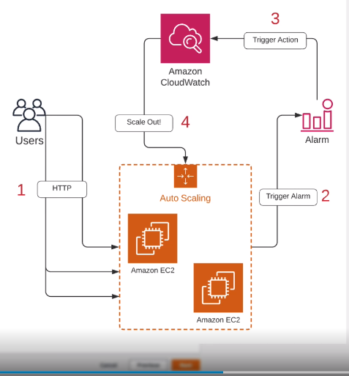

Slide 13


CloudWatch Events
Allow for near real-time streams of events that show changes in your AWS resources

Slide 14


CloudWatch Event Triggers
Scheduled
Event-based (CloudTrail)

Slide 15

Demo
Create a CloudWatch event
Scheduled
Event-based

Slide 16
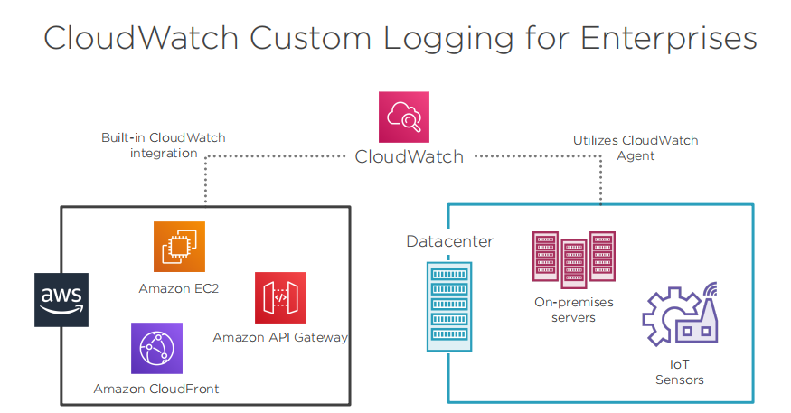

Slide 18

Module Wrap-up
CloudWatch monitors your AWS resources and applications
There are six key concepts for CloudWatch, can you name them?
Create alarms based on selected metrics Use CloudWatch events to trigger actions

